Slide 1
XRF for Soil Screening Tim Johnson Business Development Manager

Slide 2
Overview
XRF for Soil Screening
What is it?
EPA Guidance
How can it help you?
Sampling best practices
Limitations

Slide 3
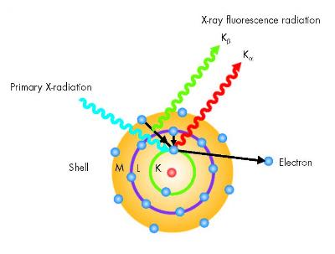
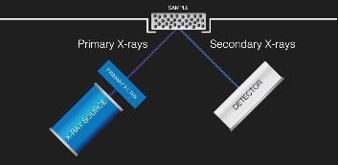
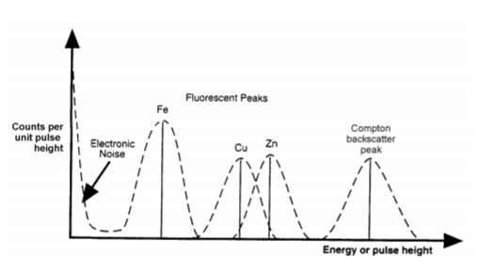
Introduction to HH XRF – How it works
X-Ray Tube generates photons that are directed towards the sample
Sample is excited and emits characteristic photon
These characteristic photons are captured and counted by the detector creating a spectrum
Peak height is proportional to concentration

Slide 4
Basics of XRF
Each element emits photon of known energy
Algorithms are written to focus on certain peaks
Proper calibration along with algorithms give a concentration in ppm or %

Slide 5
EPA guidance
“XRF may be used to obtain in situ measurements at a large number of locations in a short period of time to determine if a site warrants further attention with respect to characterization.
https://www.epa.gov/sites/default/files/2016-01/documents/field_xrf_measurement107_af.r3.pdf

Slide 6
SW-846
EPA Method 6200
Describes the methodology and QC for using portable XRF for soils and sediments
Very detailed, and seldom fully followed.

Slide 7
How can XRF benefit you?
Allows for a sight to be rapidly screened.
Results in minutes
Focus on trouble spots
Allows for fewer samples to be sent to lab for confirmatory testing (AA, ICP)

Slide 8
Sampling Techniques
2 methods for sampling (many variations)
In-situ
Invasive

Slide 9
In-situ testing
Analyzer is placed directly on the soil
Very rapid
Not as accurate
Many variables cannot be controlled

Slide 10
Variables in Soil XRF analysis
Area
Moisture
Grain size
Sample container (or lack thereof)

Slide 11
Invasive Testing
Many variations on this method
Samples removed and placed into a container
More time consuming
Additional materials needed
Greatly improved accuracy

Slide 12
Invasive testing - Good
Sample is scooped and placed into a bag
Analysis is performed through the bag
Allows for a larger sample to be analyzed than in-situ testing
Still many variables

Slide 13
Invasive testing - Better
Several samples from an area scooped into a container
Samples homogenized
Homogenized composite sample analyzed

Slide 14
Invasive testing - Best
Several samples taken from an area and mixed together.
Sample is dried
Sample is homogenized
Sample is sieved to consistent grain size
Sample is placed into an XRF cup for analysis
Cup is analyzed minimum 4 times turning each time.

Slide 15
Limitations
Accepted for screening only
Limited to 12 of the 13 priority pollutant elements

Slide 16
Questions?

